Slide 1
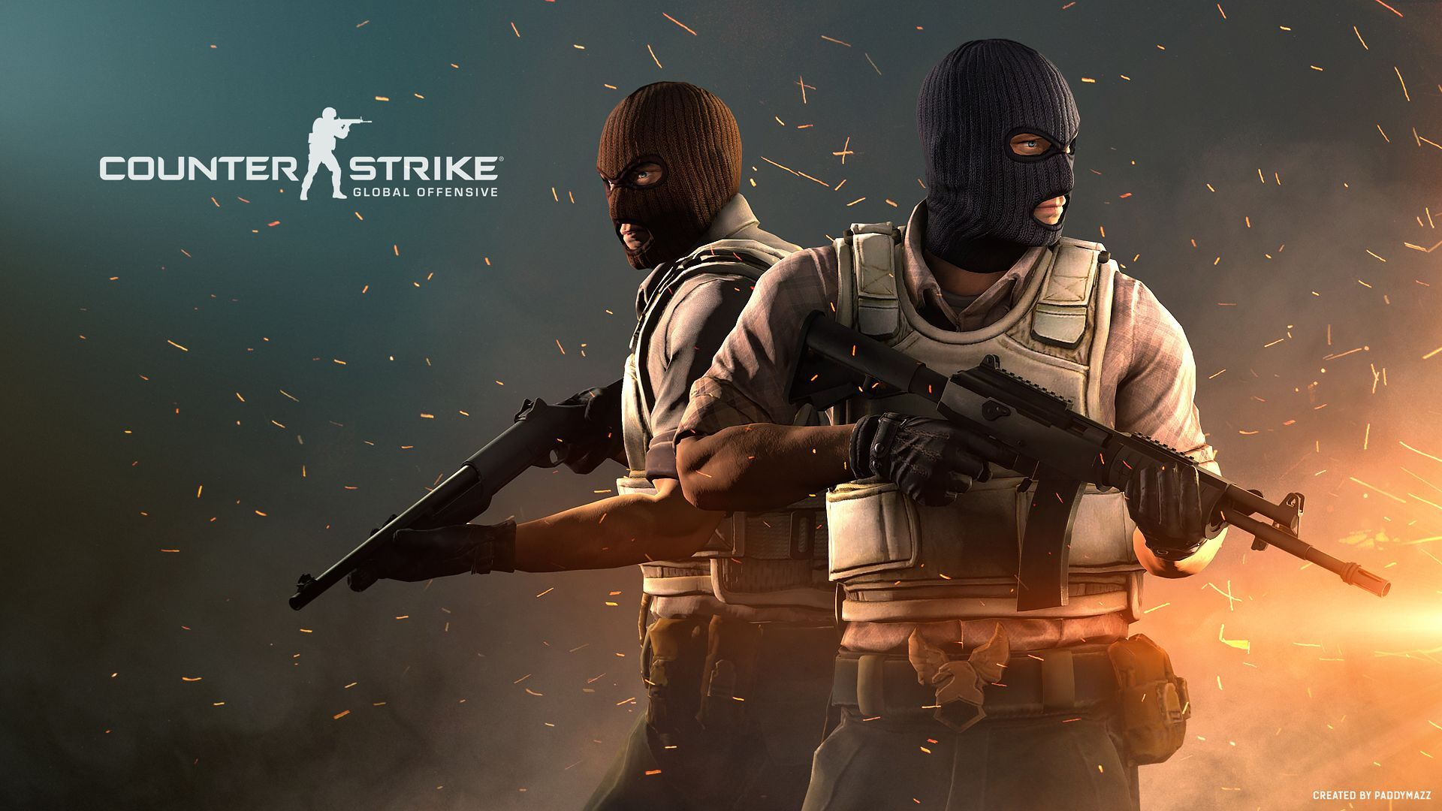

Matis Chabanat
TD2 | TP3
R1.10
BUT S1
30th September 2021

Slide 2
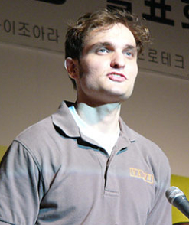
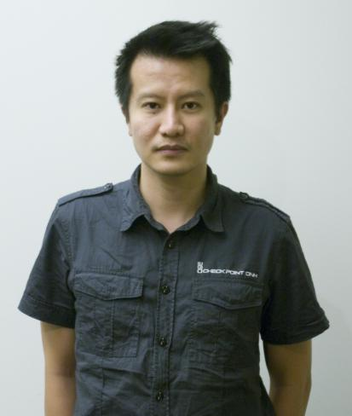
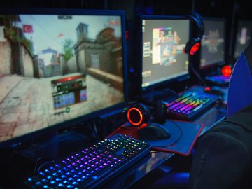


Creation
Jess Clife
Minh Le
Playable on computer
Date : august 2012

Slide 3
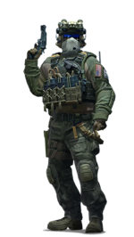
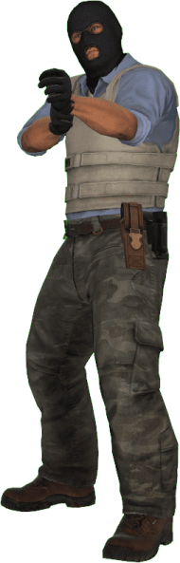



Rules of the game

Slide 4
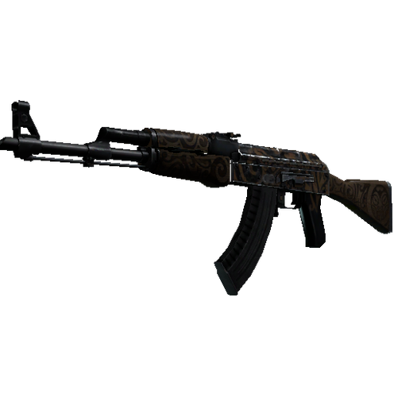
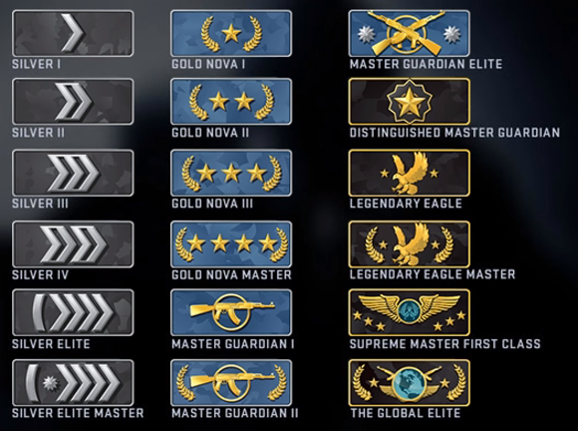
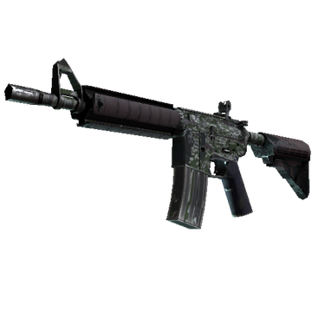
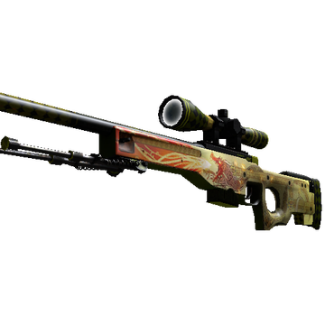
The game
Ranking system

Slide 5
Advantages | Disadvantages
Bad graphics
Best settings -> FPS
There are too many drunk
Russians on the games
Not necesarry to have a big computer
for playing csgo
Can be very funny but we can rage a lot

Slide 6

Conclusion
New game (2020) with the same rules

